Slide 1
Course Project:
A Contactless Multi-sensor System for Gesture Recognition
Bin Hu, Xin Yang, Song Yang, Zhenzhe Lin
Department of Electrical and Computer Engineering
Rutgers University
binhu.philip@gmail.com, xin.yang@rutgers.edu, sea.yang@rutgers.edu, zhenzhe.lin@rutgers.edu

Slide 2
Outline
Motivation & Objective
Related Work
Approaches
Results
Demonstration
Summary
Challenges & Future Work

Slide 3
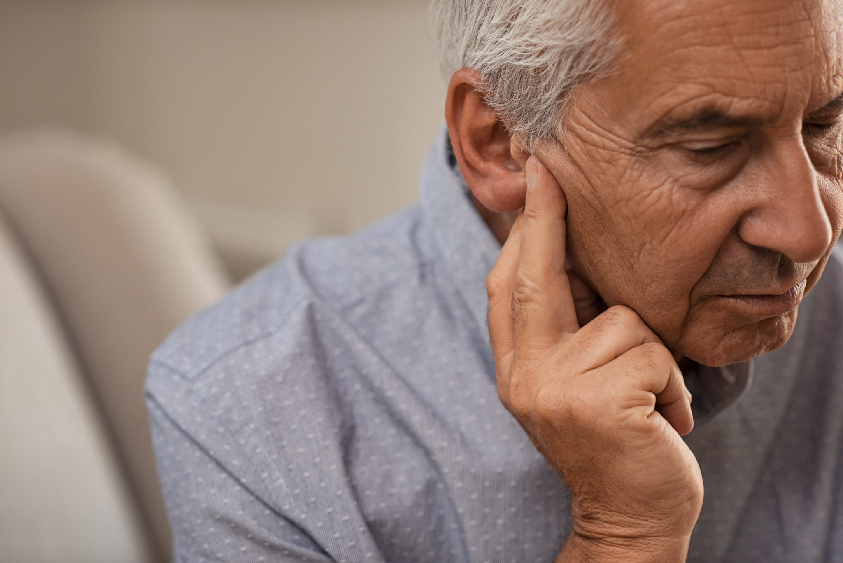
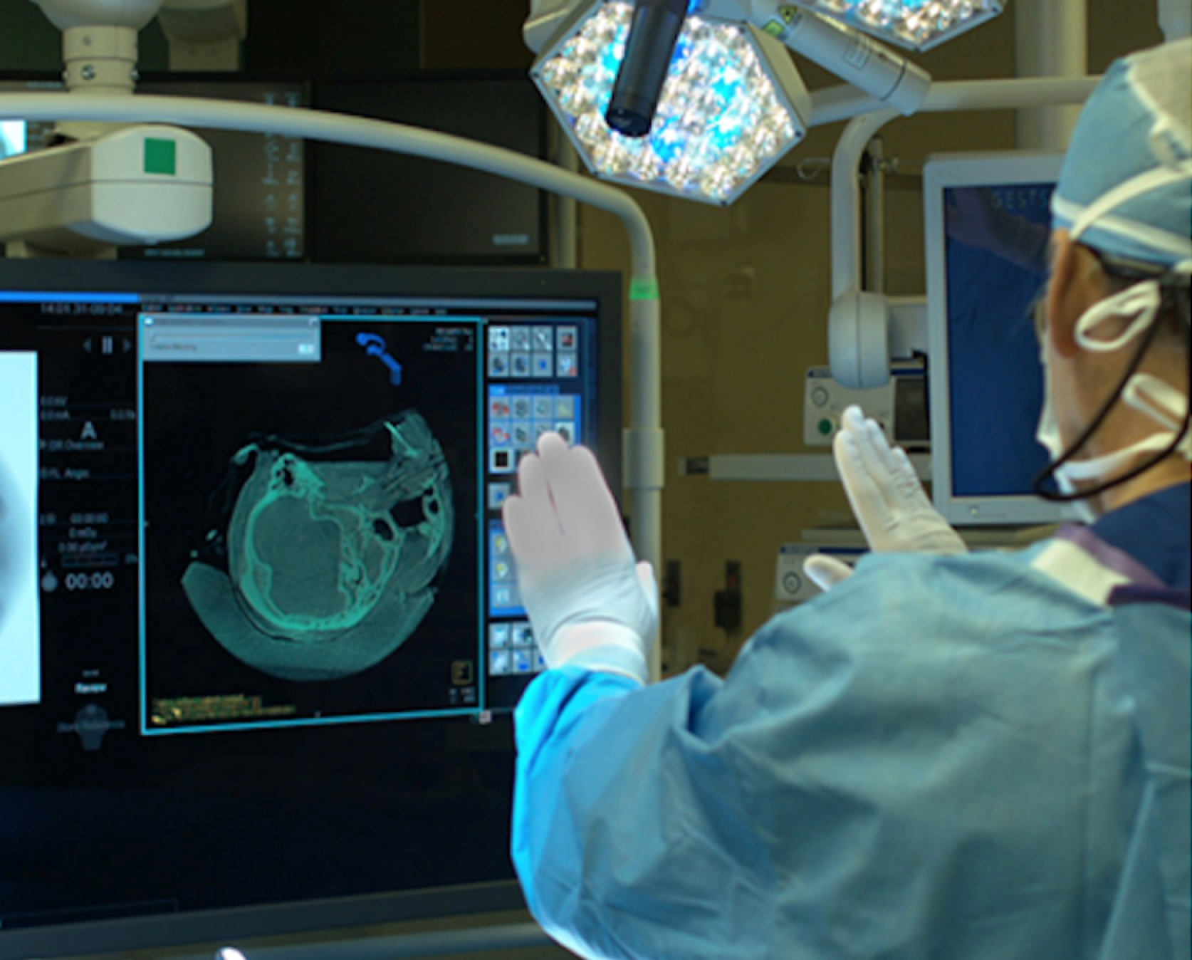
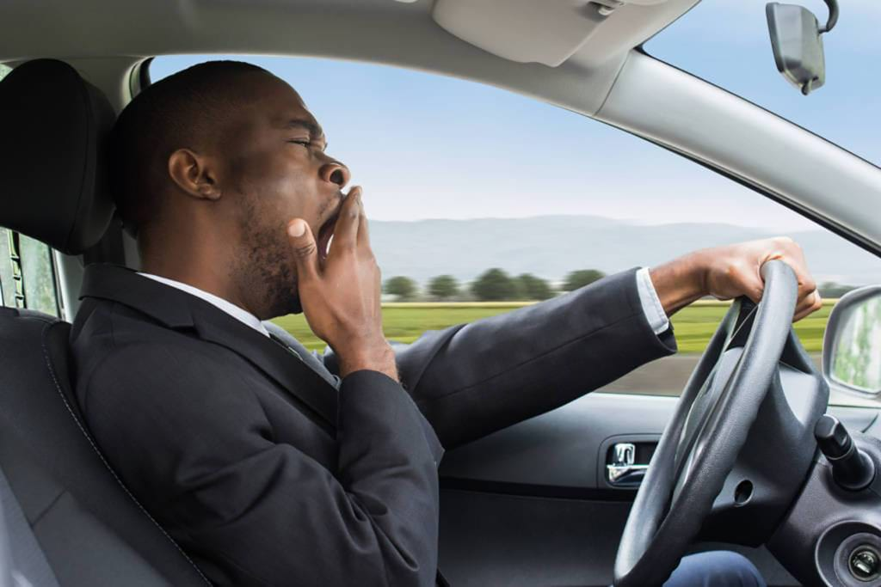
Motivation
Gesture recognition is to identify meaningful expressions of limb motion by human
Important in designing an intelligent and efficient human-computer interface
Wide-ranging applications and deployments in real scenarios
Aids for hearing impaired
Touchless surgery
Driving Monitoring

Slide 4
Related Work
Image and vision-based methods (e.g., Microsoft Kinect)
Wearable approaches with embedded motion sensors
Vision-based methods involve privacy concern, intensive computation and considerable resources
Wearables solutions require dedicated devices incurring high-cost and bring uncomfortable user experience

Slide 5

Question
Can we build a real-time low-cost & contactless system utilizing a user’s gestures to achieve remote control of smart home devices?

Slide 6
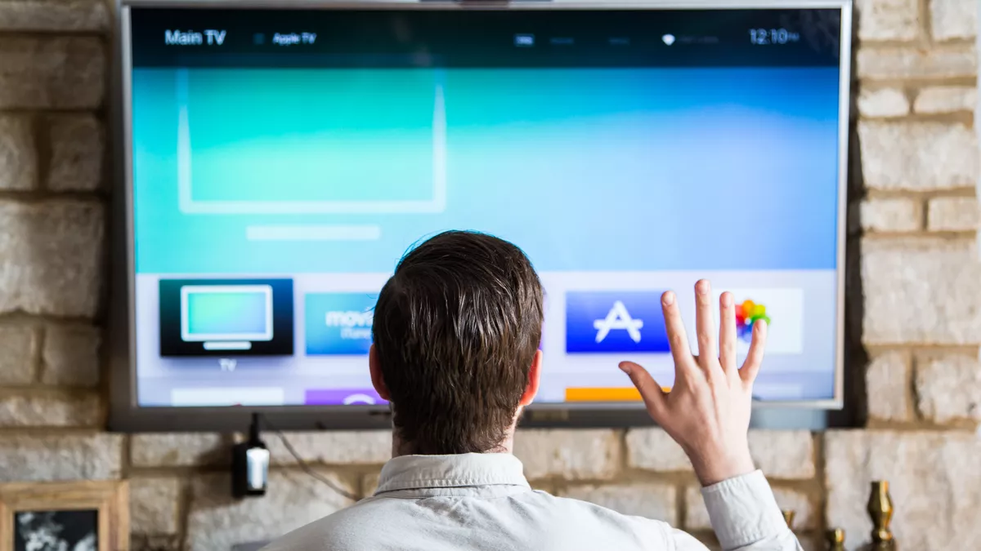
Objective
Implement a hand gesture recognition system using multiple sensors (i.e., an infrared sensor, an ultrasound transceivers and an photoregister)
Utilizing different gestures to achieve contactless gesture control of smart home devices
Contactless Gesture Control

Slide 7
Approaches
Hardware Implementation
Software Environment
Feature Extraction
Classification

Slide 8
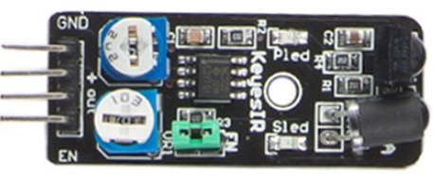
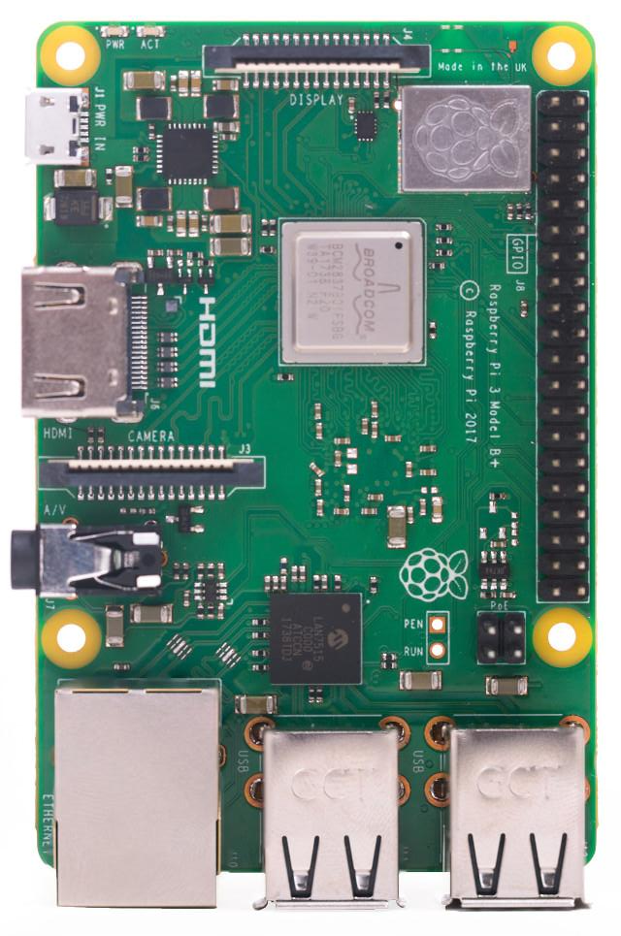
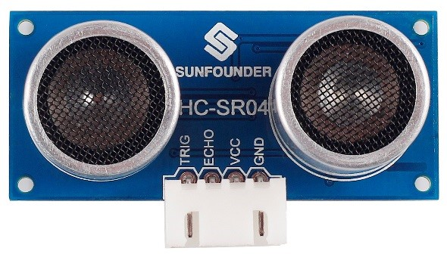
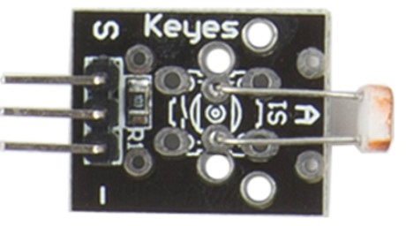
Hardware Implementation
Platform and Sensors:
Infrared Transceiver
The infrared transceiver uses reflection principle to detect objects. When there is an object block the infrared light, the infrared receiver can receive reflected signals.
Raspberry Pi 3
Ultrasound Transceiver
The ultrasound transceiver sends out ultrasonic waves and converts them into electronic signals. It can detect objects and measure distances.
Photoresistor
A photoresistor is a light-controlled variable resistor. The resistance of a photoresistor decreases with increasing incident light intensity.

Slide 9
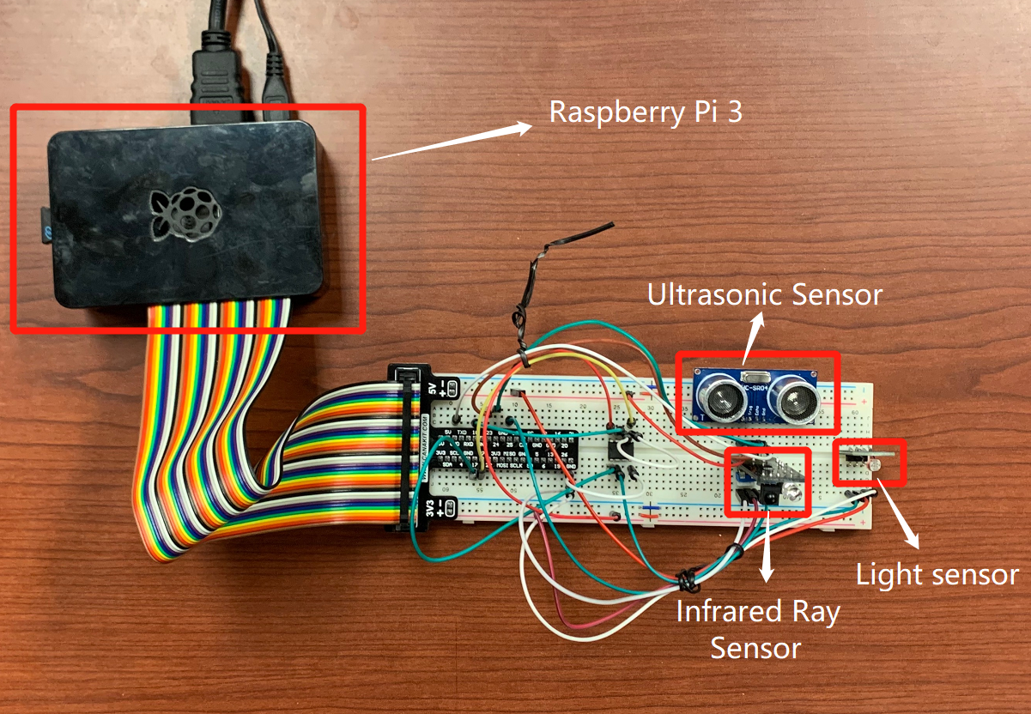
Hardware Implementation
Platform and Sensors:
Ultrasonic sensor calculate the distance value when detecting objects
Infrared transceiver return the value 1 when detecting human gestures
Light sensor (photoresistor) return the light strength value

Slide 10
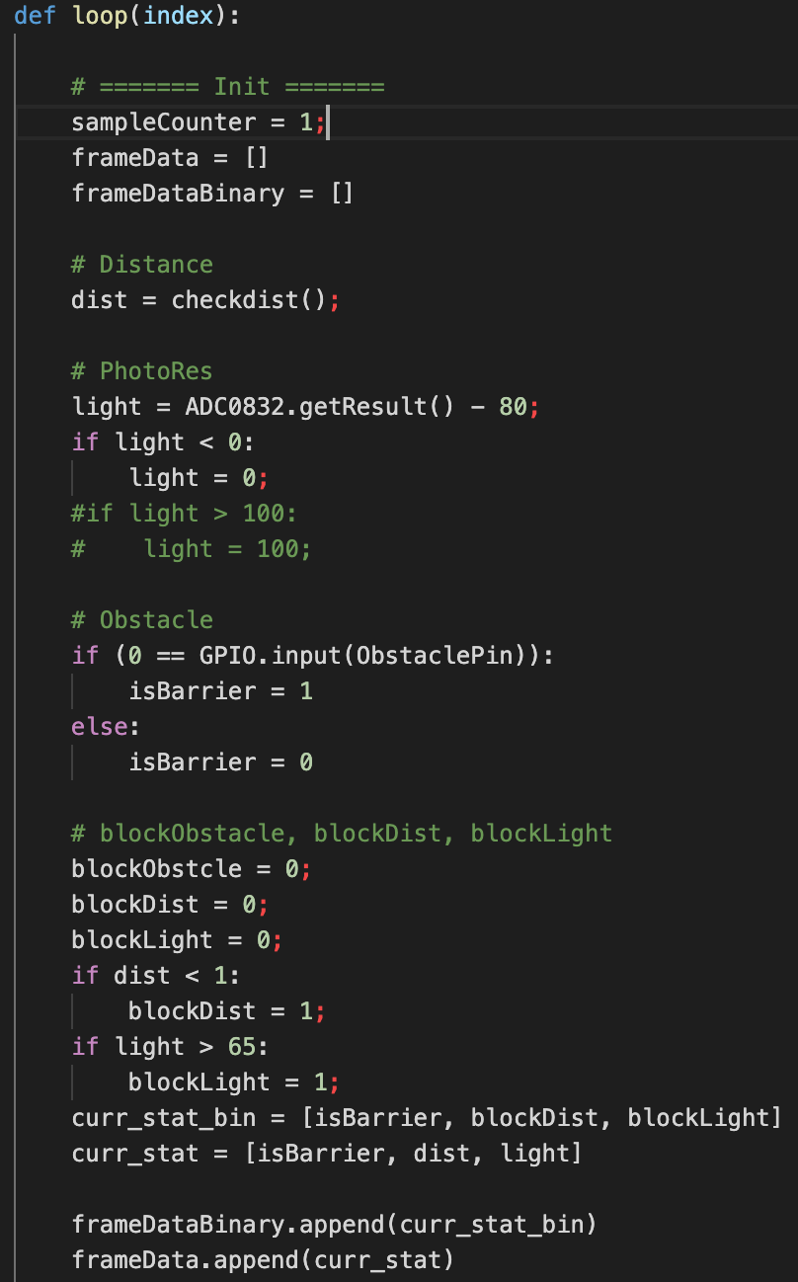
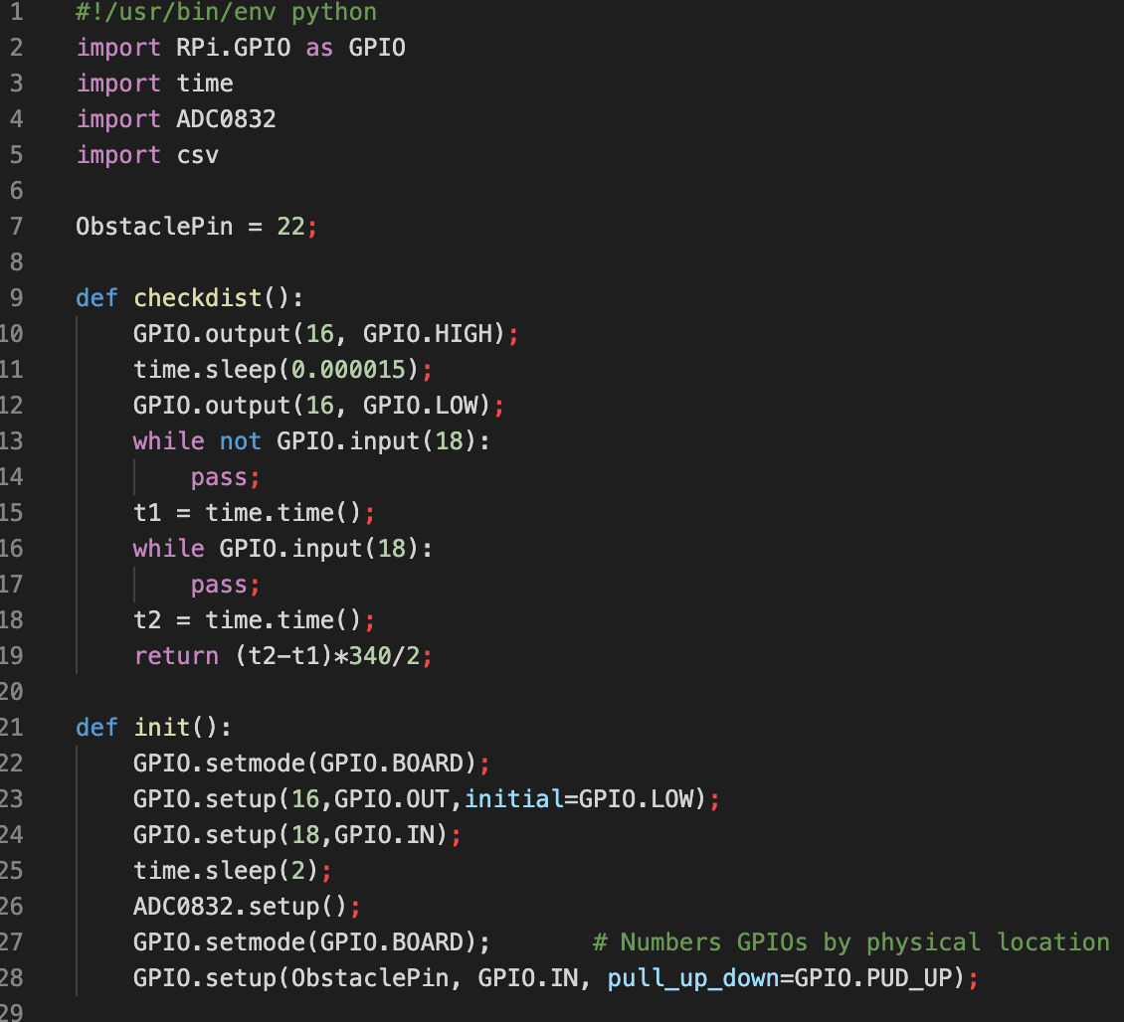
Software Environment
Raspbian OS + Conda + Python3 + Scikit-learn
Open-source libraries to control the Raspberry Pi and TI ADC0832:
RPi.GPIO¹: control ultrasound sound distance sensor and infrared obstacle avoidance sensor
ADC0832²: control the photoresistor sensor
¹https://pypi.org/project/RPi.GPIO/
²http://www.ti.com/product/ADC0832-N
Notes:
Xin

Slide 11
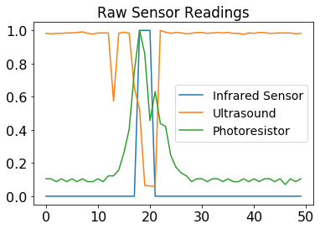
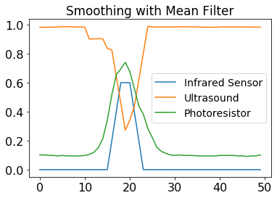
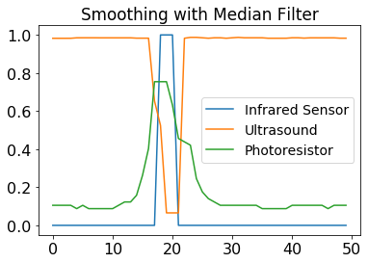
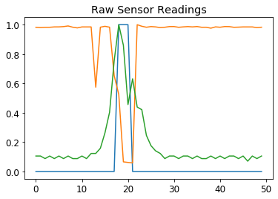
Feature Extraction
Synchronization
Synchronize all sensor readings to 33Hz sampling rate by using downsampling and data interpolation.
Data Preprocessing:
Median-filter: Median filter is more robust to outliers.
Normalization: Unify sensor readings to [0, 1].
Feature Extraction:
Use a sliding window to extract features.
Signal
A Sliding Window Approach

Slide 12
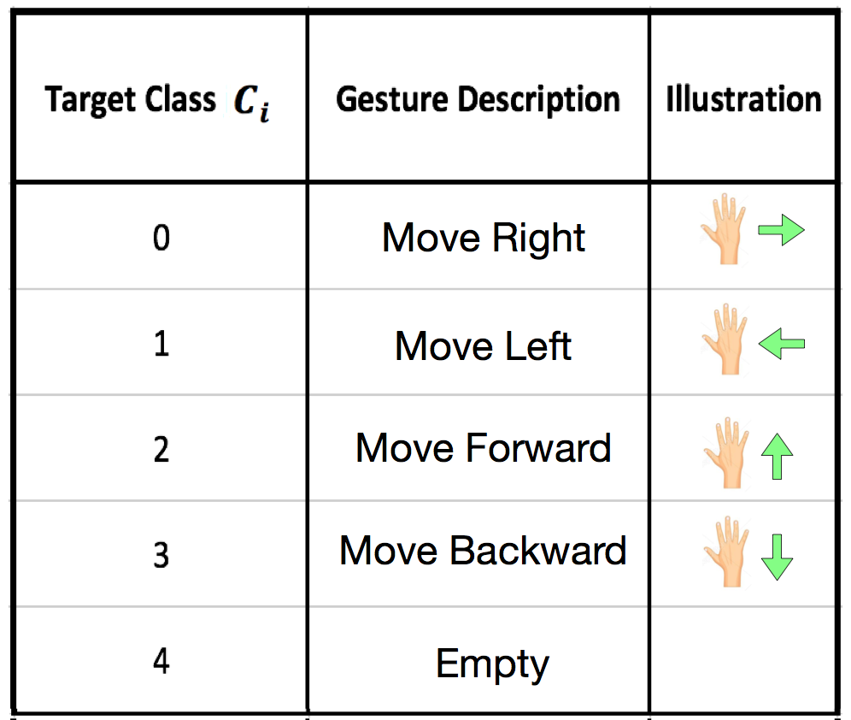
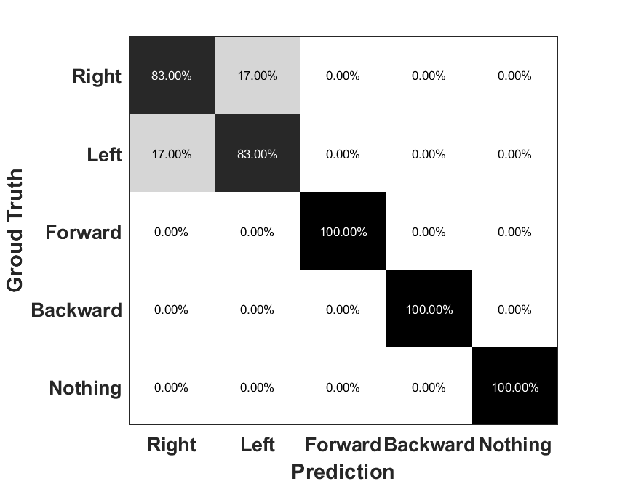
Classification
Support Vector Machine (SVM): Linear Kernel
Dataset:
Sampling Rate: 33 Hz.
Training: 100 samples, 20 for each gesture.
Validation: 20 samples, 4 for each gesture.
Testing: 30 samples, 6 for each gesture.
Classification Accuracy: up to 96%

Slide 13
Demo

Slide 14
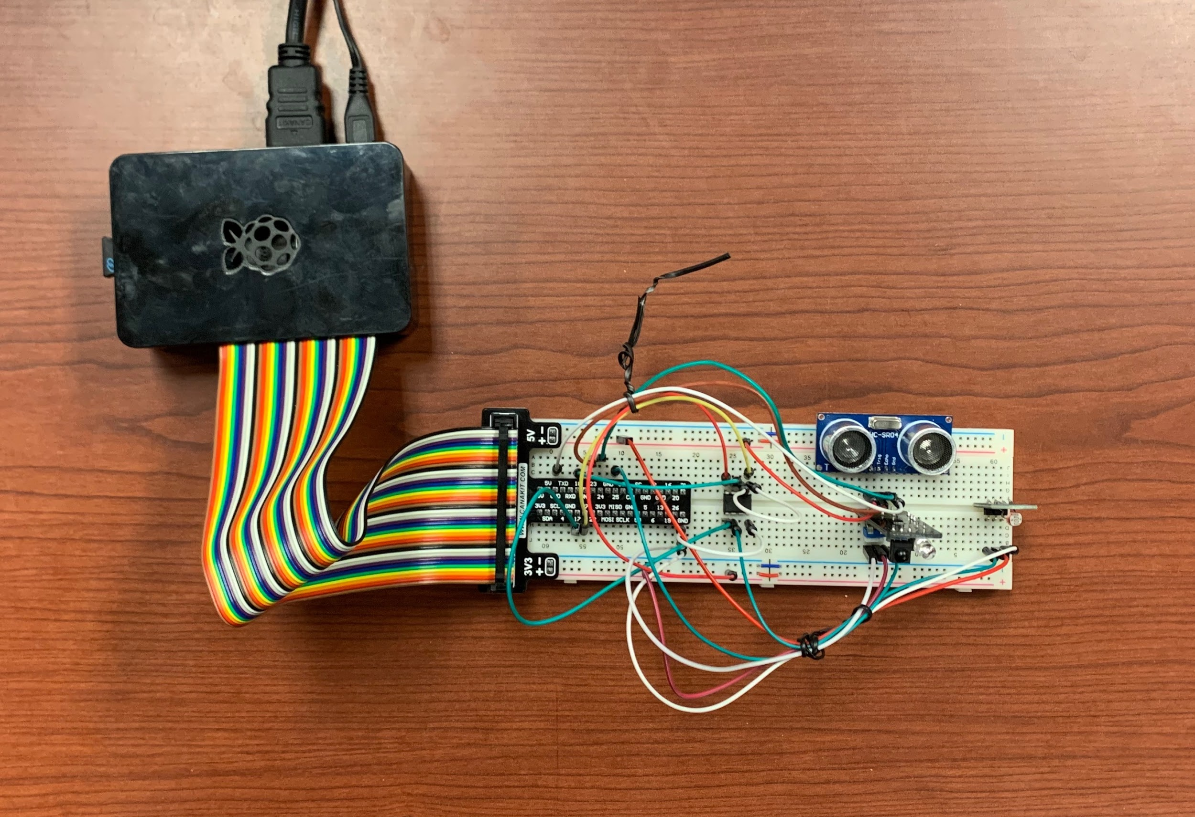
Summary
We build a gesture recognition system leveraging infrared transceiver, photoresistor, ultrasound transceiver based on Raspberry Pi
Our system could recognize 4 gestures + ambient environment in real-time
Our system could achieve up to 96% recognition accuracy

Slide 15
Challenges & Future Work
Challenges:
Software setup: Raspberry Pi 3 uses ARMv7 architecture but lots of packages are compiled for x86 architecture
Pre-trained model is sensitive to the ambient light changes
Future Work:
Support more gestures with more training data
Enhance the sensing resolution by adding more sensors
Actively fit the ambient light brightness

Slide 16
Workload Distribution
We distribute our works equally
Bin, Xin:
Software environment setup (conda, Python 3)
Coordinate the sensor readings and the classification program
Machine learning model training/inference (sklearn.svm)
Song, Zhenzhe:
Raspberry Pi hardware implementation, test sensor APIs
Data preprocessing method
Feature extraction algorithm

Slide 17
Thanks!
Q&A

